Slide 1
Website Redirection using Cross site scripting
Neetal Chaudhri( D17C, 10)
Sharvari Jalit( D17C, 23)
Mrunmayee Mujumdar( D17C, 46)

Slide 2
INTRODUCTION
Scripting: Web browsers can execute commands
Embedded in HTML pages
Supports different languages (JavaScript, VBScript,etc)
Most prominent: JavaScript
“Cross-site” means: Foreign script sent via server to client
Attacker makes Web server deliver malicious script code
Malicious script is executed in Client’s Web Browser
Attack:
Steal Access Credentials, Denial-of-Service, Modify Web pages
Execute any command at the client machine

Slide 3
PROBLEM STATEMENT
The latest advancements in the internet and communication technology has made day-to- day life fully dependent on web applications as all the facilities are available at just one click.
Website Redirection is one of the application layer vulnerabilities that targets web applications by embedding scripts in a web page that will get executed at client side or server-side and the attacker will manipulate the information in desired manner.

Slide 4
Consequences
Cookie theft
Key logging
Phishing

Slide 5
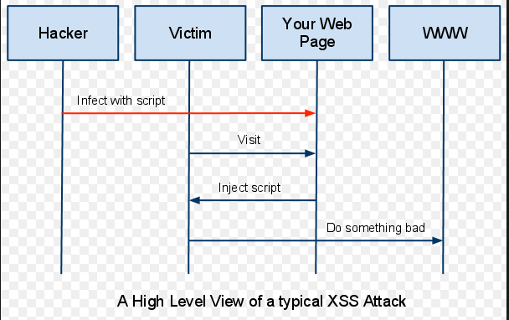
DESIGN / ARCHITECTURE DIAGRAM

Slide 6
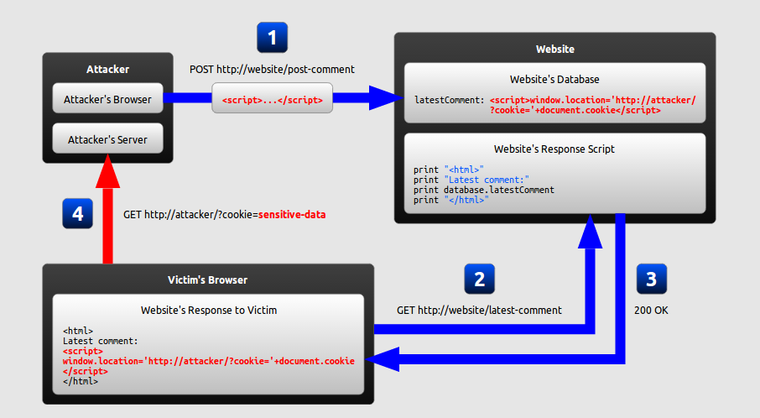
PROPOSED WORK
Notes:
The attacker uses one of the website’s forms to insert malicious string into the website’s database.
The victim requests a page from the website.
The website includes the malicious string from the database in the response and sends it to the victim.
The victim’s browser executes the malicious script inside the response, sending the victim’s cookie to the attacker’s seerver.

Slide 7
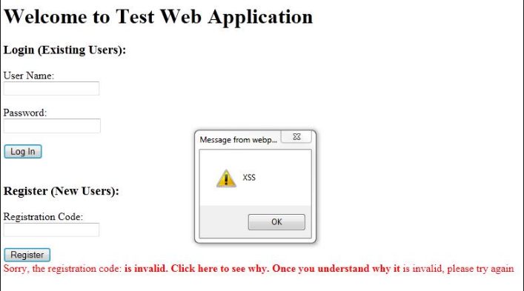
EXAMPLE

Slide 8
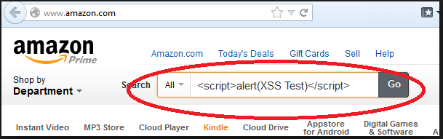

Slide 9
Prevention
Encoding
Validation

Slide 10
PREVENTION
Redirection to another site occurs because the comment entered by the user is not examined for any malicious code and is directly stored in the database.To prevent website redirection we filter out the malicious content and display only the text.Thia can be achieved by using the strip_tags function in php.Strip_tags function filters out all the html tags in the string given to it.

Slide 11
FUTURE SCOPE
A Cross-site request forgery attack, also known as CSRF or XSRF (pronounced sea-surf) is the well known, but equally dangerous like the Cross Site Scripting (XSS) attack.
The cross-site scripting preventor system can be further improved by integrating the CSRF prevention mechanism.
The session hijacking prevention can be further enhanced, based on complex encryption techniques and taint information flow in web applications.

Slide 12
CONCLUSION
We observed that Cross-Site Scripting (XSS) is probably the most common singular security vulnerability existing in web applications. We have thus demonstrated one of the possible attacks in XSS and provided a possible solution.

